Slide 1
Pomodoro App
Individual Project: Seth Beesley

Slide 2
Summary
This application is a Pomodoro Timer. It is a time management tool used to break work into intervals (traditionally 25 minutes in length), separated by short breaks of 5 minutes. It has the following features:
Starting/Resetting Options
Progress Bar
Ringing Sound Effect
Fruit Changer Option

Slide 3
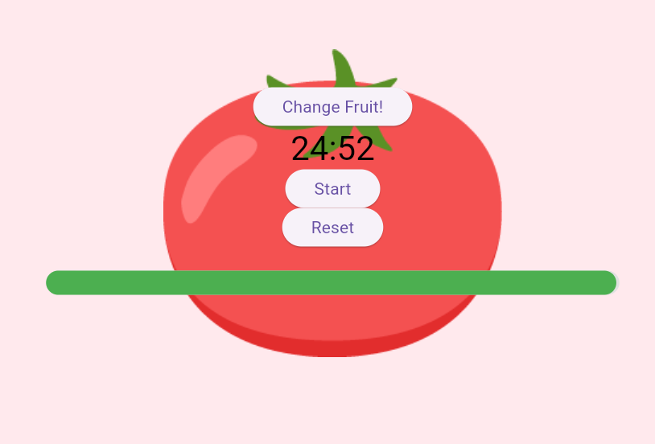
Feature 1: Starting/Resetting Timer
The user is able to start the timer, as well as reset the time. The given time is indicated at the top. Simple press ‘Start’, and the countdown will begin. You cannot stop it (just like a real Pomodoro).

Slide 4
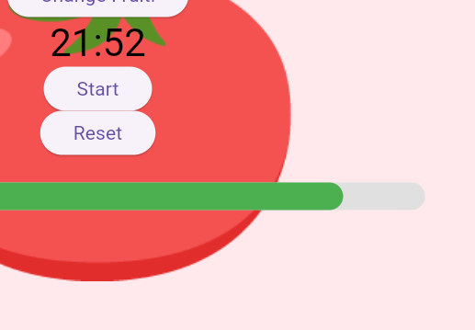
Feature 2: Progress Bar
A progress bar will be displayed, changing based on how far the countdown is.

Slide 5
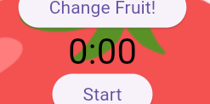

Feature 3: Ringing Sound Effect
A sound effect will play upon reaching 0. This feature will incorporate a sound similar to an alarm clock. It is loud, but at the same time, pleasant to the ears.

Slide 6
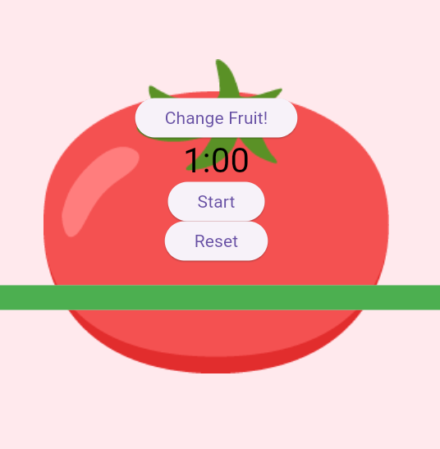
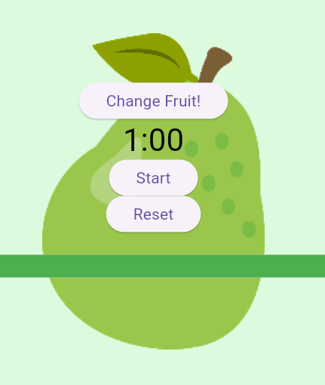
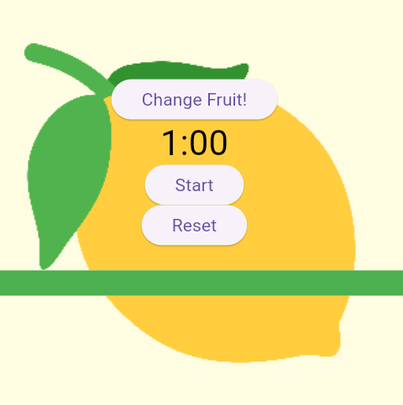
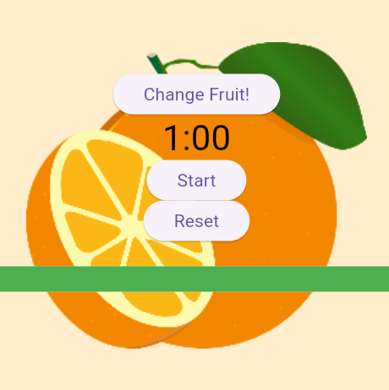
Feature 4: Fruit Changer
The user is able to change the fruit of the pomodoro, changing the background accordingly.

Slide 7
Progress
Lines of Code
Initial Lines of Code: 74
Final Lines of Code: 217
Testing
5 Unit Tests, 4 Integration Tests
89% Test Coverage

Slide 8
Lessons Learned
Taking user-needs into account
Working with state management
Taking user interface into serious consideration (for condensability)
Starting early, finishing early

